Slide 1


ZamblApp
The perfect Android application for your Electronics Shop
Antonio Gomès (202111218)
Claudio Savelli (202111375)
Eliott Tardieu (202111217)

Slide 2
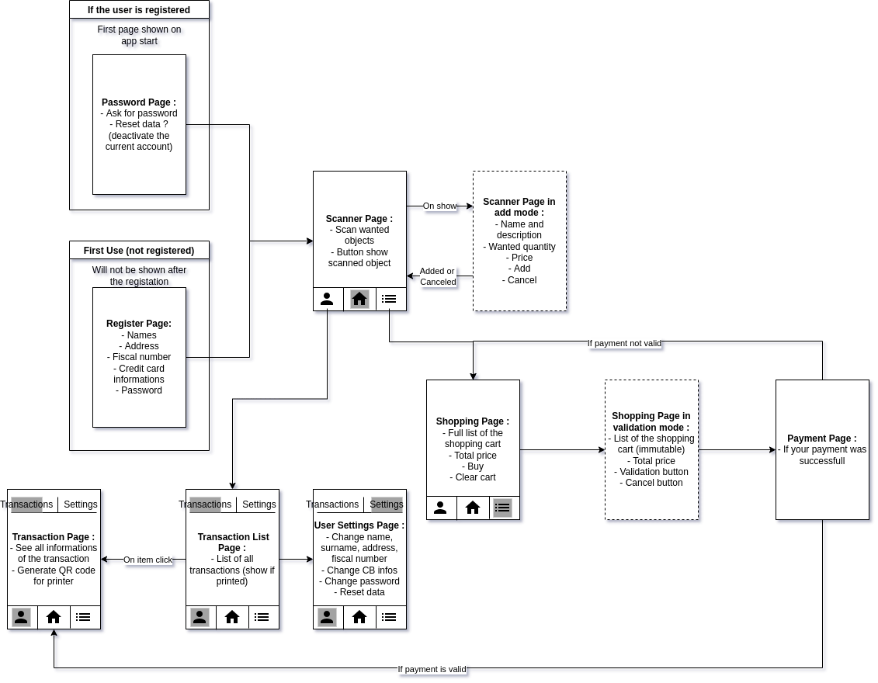

The Application Design

Slide 3
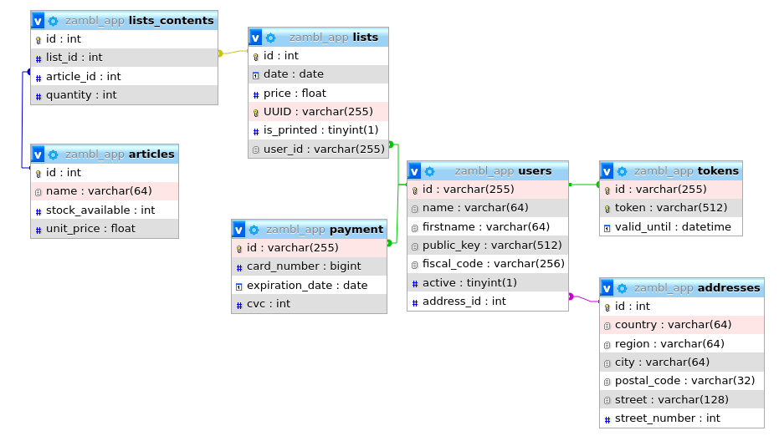
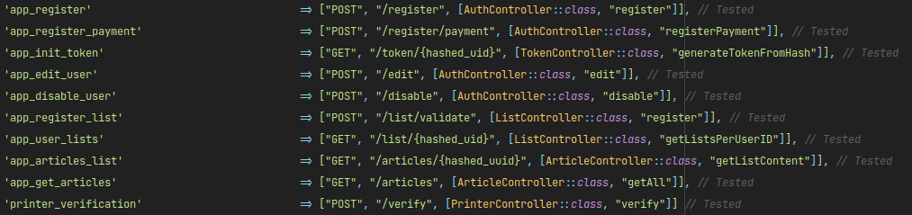

The Server Design

Slide 4
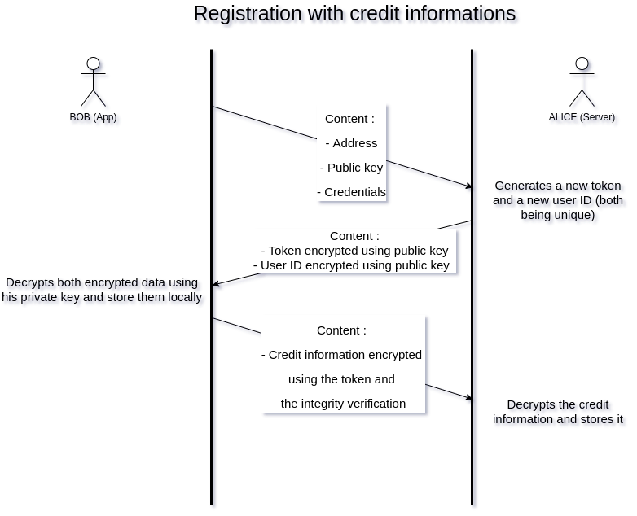
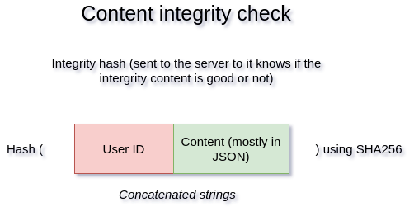

The Security Design

Slide 5




Main Library Used
Jetpack Compose
ML Kit
Volley
Gson

Slide 6
Thank you for the attention!
Now the practical presentation will begin

Slide 7
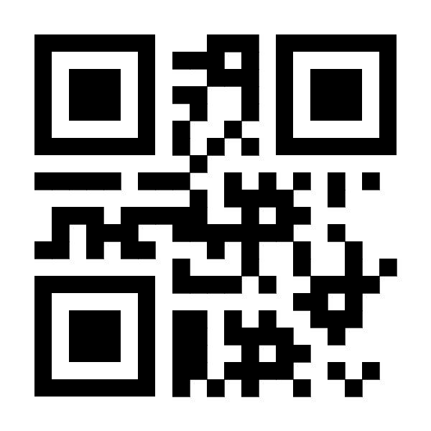
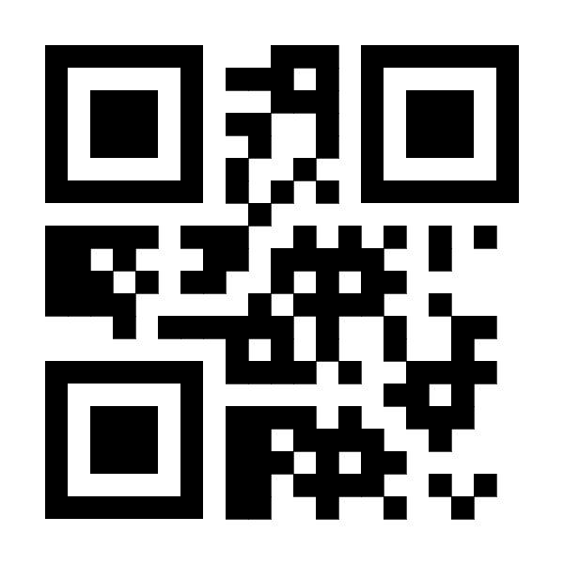
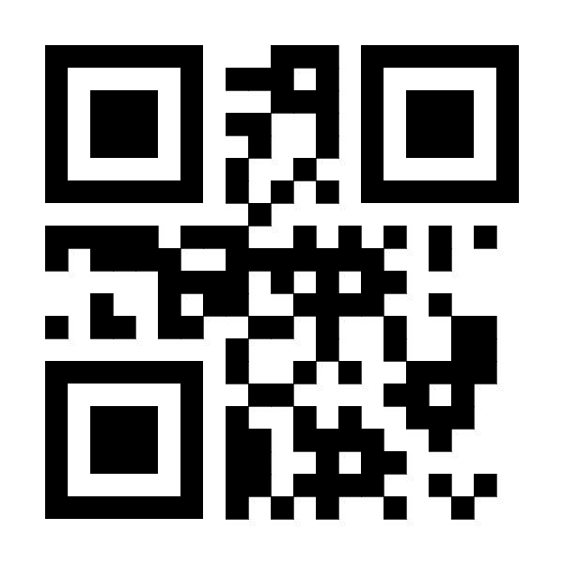
QR codes examples:
Smartwatch 2
MacBook 12
Iphone 12

